Slide 1
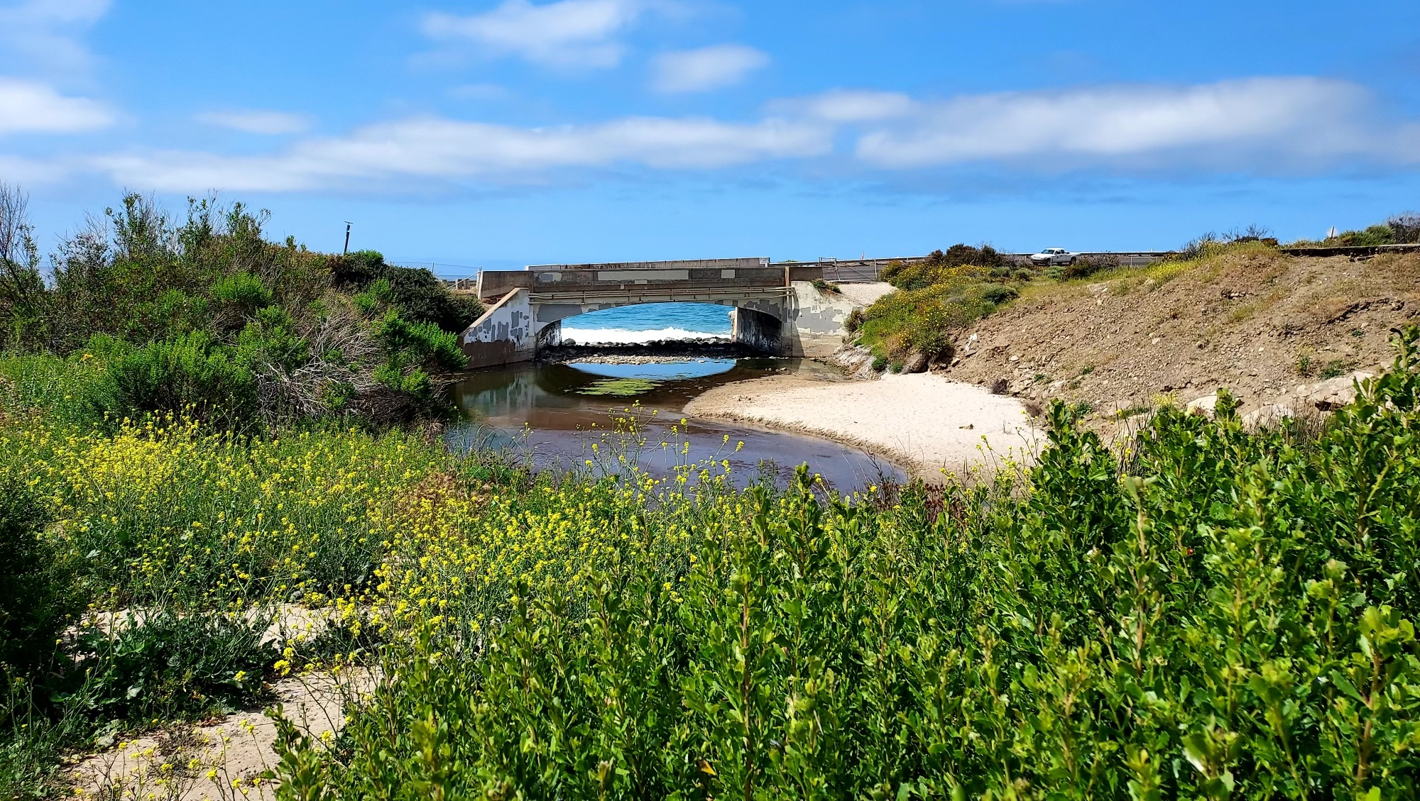

Restoration Monitoring Approaches: Lessons From California
Eric D. Stein – Southern California Coastal Water Research Project

Slide 2
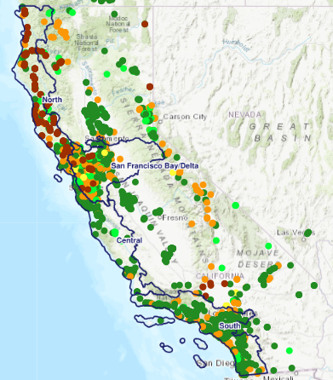
Can Monitoring Help Us Judge Success?
What is success?
How does our concept of success change over time?
What tools and approaches are most effective?
Source: EcoAtlas

Slide 3
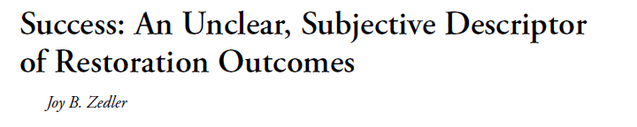
Ecological Restoration 2007
The pathway of restoration is often slow and not necessarily smooth. In addition, people involved will evaluate a project as a success or failure depending on their interests as well as specific measurements used to evaluate.
Assessments of success depend on perspective, goals, and time

Slide 4
Lessons Learned in California
Success is in the eye of the beholder
Collaboration is key to gauging success
Evaluation of success requires context
Meaningful conclusions about success take time
None of it matters if you can access and interpret the data

Slide 5
Success is in the Eye of the Beholder
The definition of success depends on the functions prioritized for the restoration project; therefore, a function-based monitoring program is essential

Slide 6
Success is Based on the Functions Prioritized by Each Restoration Project
Nekton Habitat | Primary Production
Protected Species Support | Secondary Production
Nutrient Cycling | Sea level rise amelioration and resilience
Bird habitat | Shellfish support
Nursery habitat | Support of vascular plant communities
Wildlife support
Notes:
This EMPA framework takes an ecosystem function-based approach to assessing the condition of estuarine ecosystems, with the underlying principle that all healthy estuaries should provide a suite of ecological functions and ecosystem services and that failure to do so is an indication of degradation.
This approach is unique in that it focuses on assessing function, rather assessing species or habitat. This builds in flexibility for application within a highly heterogeneous system or state, like California.
Our technical team identified 11 priority ecological functions to focus our framework around.

Slide 7

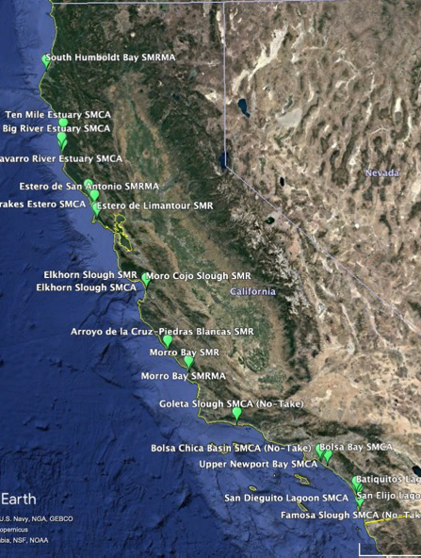

Estuarine Marine Protected Area
Monitoring Program (eMPA)
The California Estuarine Marine Protected Area (EMPA) Monitoring Program is an ongoing effort to assess the quality and condition of estuaries statewide.
The program goals are to monitor California estuaries with a standard, comprehensive function-based assessment framework to determine the health of California’s estuaries and the efficacy of MPA designation.
Notes:
OPC funded the state-wide team to develop the framework to address this fundamental question of estuary MPA effectiveness
Now - A key element is the development of a standardized monitoring protocol that can be used not only by the MPA program, but by any program aimed at assessing estuary function, condition, or health to provide data that can be easily compared across systems and between programs.

Slide 8
Multiple Indicators Can be Used to Assess a Given Ecological Function
Estuary |  | Indicators
 |  | Water quality | Water nutrient concentration | General community composition (eDNA)
Functions | Nekton Habitat
 | Primary Production
 | Secondary Production
 | Protected Species Support
Prioritize indicators for inclusion based on functions of interest:
  Key ecological functions
  Designated goals
Green squares represent the indicators that can be used to evaluate function
Notes:
Simultaneously, the technical team thought about the indicators to use to assess a given ecological function, where multiple indicators can be linked to given ecological functions
Green squares represent the indicators that can be used to evaluate function.

Slide 9
Estuaries |  | Indicators
 |  | Water quality | Water nutrient concentration | General community composition (eDNA) | Sediment characteristics | Benthic infauna abundance/diversity | SAV/macroalgae distribution | Fish abundance/ diversity | Crab abundance/ diversity | Marsh vegetation distribution/ diversity/ invasives | Marshplain elevation | Sediment accretion rates | Mouth dynamics | General habitat condition
Ecosystem Functions | Nekton Habitat
 | Primary Production
 | Secondary Production
 | Protected Species Support
 | Nutrient Cycling
 | SLR Amelioration
 | Bird Habitat
 | Shellfish Support
 | Nursery Habitat
 | Support Vascular Plants
 | Wildlife Support
Notes:
For estuaries, we chose 13 indicators

Slide 10
Estuaries |  | Indicators
 |  | Water quality | Water nutrient concentration | General community composition (eDNA) | Sediment characteristics | Benthic infauna abundance/diversity | SAV/macroalgae distribution | Fish abundance/ diversity | Crab abundance/ diversity | Marsh vegetation distribution/ diversity/ invasives | Marshplain elevation | Sediment accretion rates | Mouth dynamics | General habitat condition
Ecosystem Functions | Nekton Habitat
 | Primary Production
 | Secondary Production
 | Protected Species Support
 | Nutrient Cycling
 | SLR Amelioration
 | Bird Habitat
 | Shellfish Support
 | Nursery Habitat
 | Support Vascular Plants
 | Wildlife Support
Notes:
Landscape, resiliency focused
**Going to build these out this year

Slide 11
Collaboration is the Key to Gauging Success
Development and application of consistent methods allows for leveraging of efforts
Buy-in among all agencies and partners is important to developing consensus about success

Slide 12
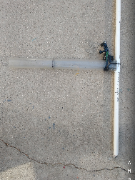
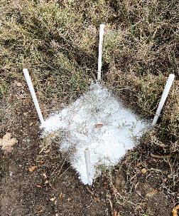
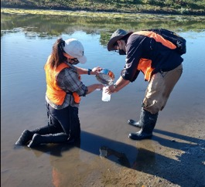
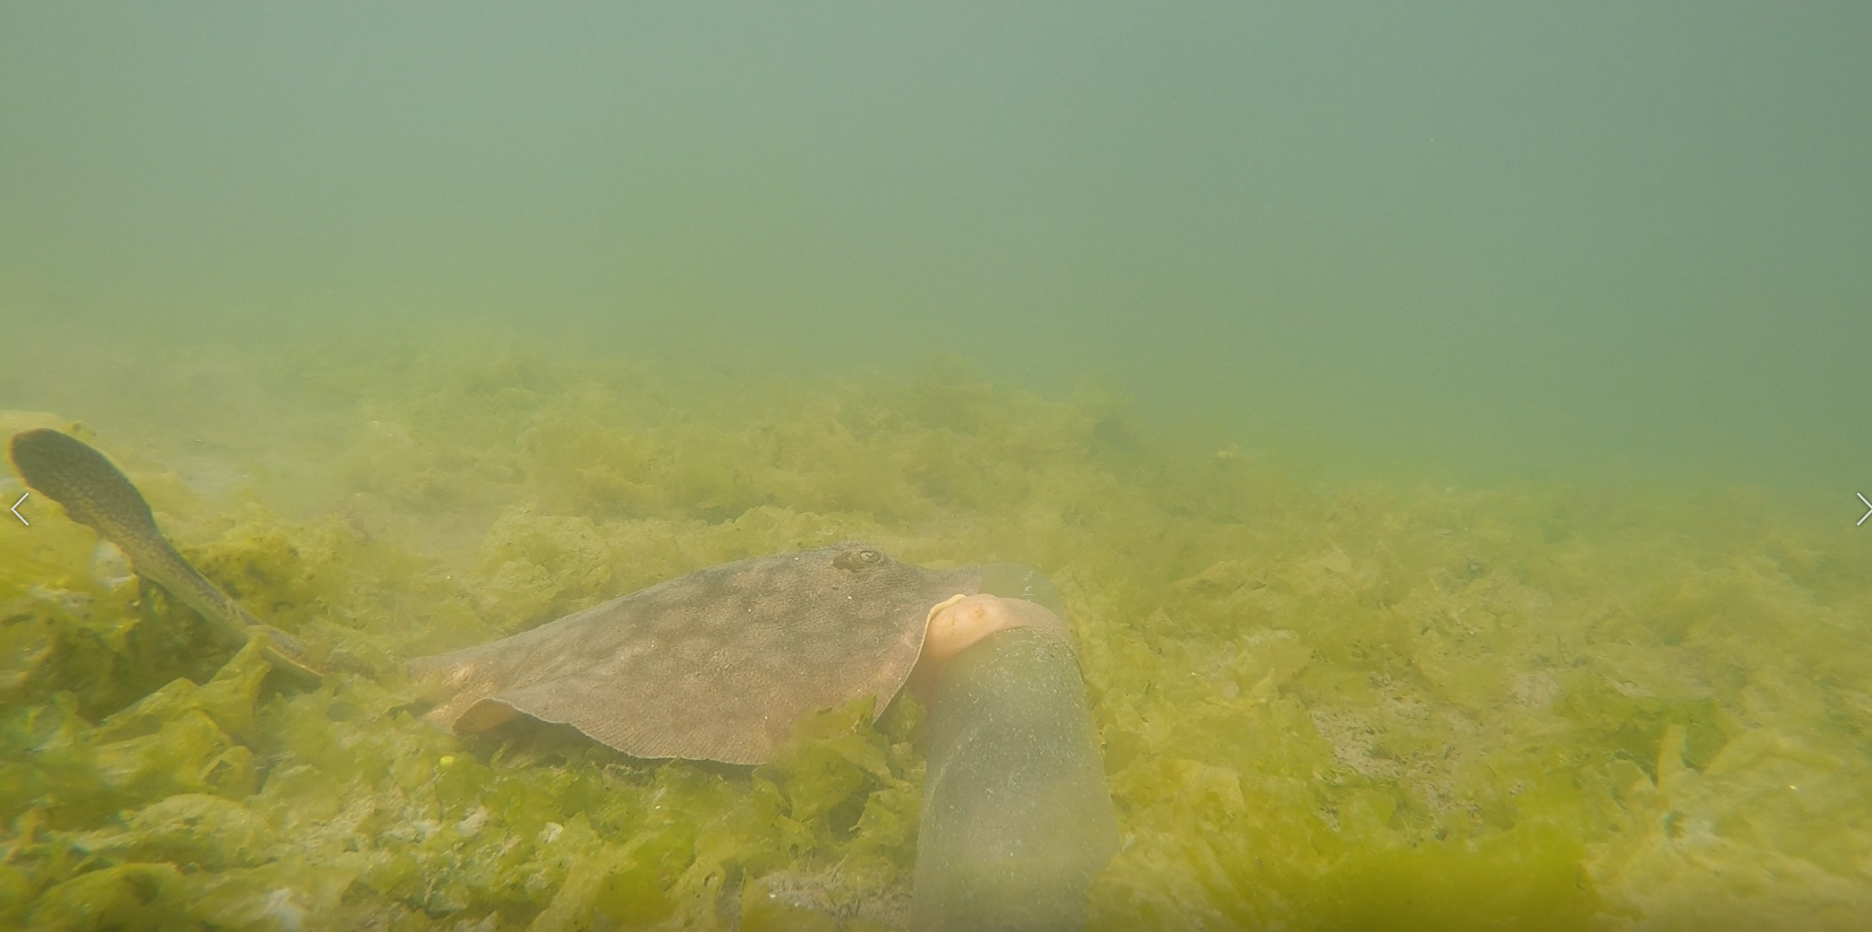
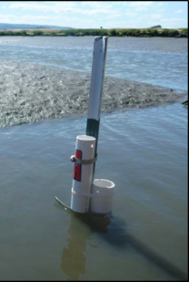
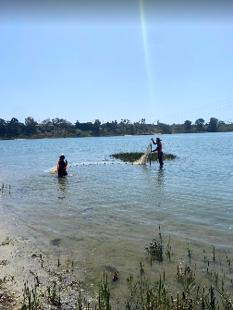
Standard Monitoring Protocols
Abiotic Factors:
  In-situ water parameters
  Basic water chemistry and nutrients
  Sediment cores
Biotic Factors:
  Fish surveys, BRUV
  Crab surveys
  Benthic invertebrates
Estuary Habitat Surveys:
  Estuary Habitat Condition (CRAM)
  Marsh Plain Vegetation and Topo Surveys
  SAV Surveys
  Community Composition Assessments (eDNA):
  SLR Vulnerability and Marsh Plain Accretion Rate Estimates
Watershed Processes and Stressors:
  Trash/microplastics
  Landscape Stressors
  Historical Habitat Change Analysis

Slide 13














Management Advisory Council
Notes:
A key component of this framework was to build consensus around the framework and monitoring protocols. We engaged with a diverse Advisory council to achieve this.

Slide 14
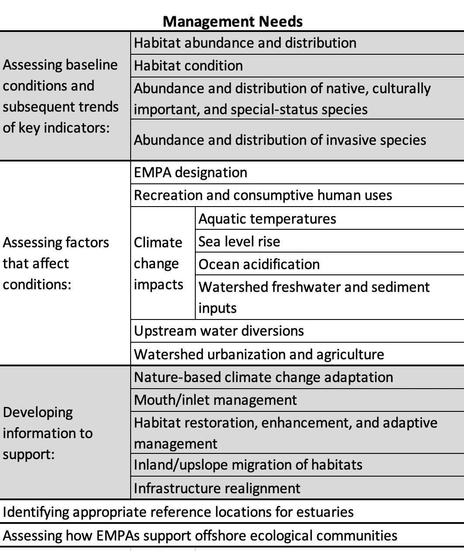
Management Questions Developed by the MAC
Assessing baseline conditions and subsequent trends of key metrics in EMPAs and non-EMPA estuaries:
  Abundance, distribution, and conditions of habitats
  Populations of native, culturally important, and special-status species
  Populations of invasive species
Assessing the impacts of the following:
  Conservation status
  Recreation
  Climate change, including sea level rise, ocean acidification, and flow/sediment delivery
  Upstream water diversions, pollution, and watershed management
Developing information to support planning for:
  Mouth/inlet management
  Restoration, enhancement, and adaptive management
  Inland migration of habitats
  Infrastructure re-alignment

Slide 15
Partnering with Permitting Agencies
Incorporate standard protocols to:
  assess condition
  evaluate alternatives
  Identify potential mitigation areas
Use indicators and protocols in mitigation monitoring requirements and performance standards
Support and take advantage of the sentinel site/reference site monitoring
Incorporate data into estuary portal

Slide 16

California Water Quality Monitoring Council & California Estuary Monitoring Workgroup (CEMW)
California Water Quality Monitoring Council
  Established by Ca. Legislature in 2006 (SB 1070)
  Co-chaired by Natural Resources Agency and CalEPA
Two Major Goals:
  Improve coordination of water quality monitoring programs in California
  Make information more accessible to agencies and the public (web portals)
California Estuary Monitoring Workgroup
  improve data sharing and access to help leverage resources
  share tools and approaches and increase standardization
  Current priority initiatives
    Website/catalogue of existing monitoring programs in California
    Develop statewide guiding questions and conceptual models
Notes:
California is in the process of developing a State Wetland program.
In November 2007, Senate Bill 1070 mandated the establishment of the California Water Quality Monitoring Council.
The goals of the MC are to develop specific recommendations to improve the coordination and cost-effectiveness of water quality and ecosystem monitoring and assessment, enhance the integration of monitoring data across departments and agencies, and increase public accessibility to monitoring data and assessment information in California.

Slide 17
Evaluation of Success Requires Context
There needs to be a common set of sentinel sites to help contextualize site-specific monitoring results
There should be coherence between regional and site-based monitoring

Slide 18
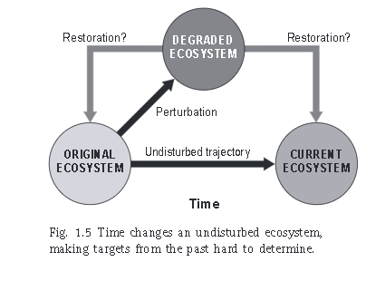
Successful Relative to “What”: Setting Expectations
Sentinel site
  Reference sites
Ambient condition
Regional/watershed goals
Harris and Van Diggelen 2006

Slide 19
Building a Sentinel Site Network
Sentinel site: Wetlands that are designated for long-term monitoring to track ecological condition through time, evaluate the effect of regional trends in external conditions/stressors, and as a basis of comparison (context) for restoration or mitigation sites
Three categories:
Reference - sites that reflect the least altered wetlands in the landscape, and often the sites used to compare reference conditions for project-specific monitoring (not all sites will be reference for all functions).
Restoration – sites that have been or are presently being restored. These sites have undergone large-scale restoration and are sites that can be tracked over time to understand their long-term ecological progression.
Impacted/Degraded – sites that are identified to be impacted by or at risk of impact from factors such as a major development project. These sites could also be heavily degraded.

Slide 20
Defining Reference
  Reference: Sites that reflect the least altered wetlands in the landscape, and often the sites used to compare to for project-specific monitoring.
  We are evaluating reference at the landscape level, not per indicator. A reference site is not indicator specific, rather a site is chosen more based on minimal stressors.
  We want sites with the highest functional performance possible across all archetypes.
  We want resilient reference sites, where structure and function remain high regardless of stress.
  The criteria for reference may be region specific.

Slide 21
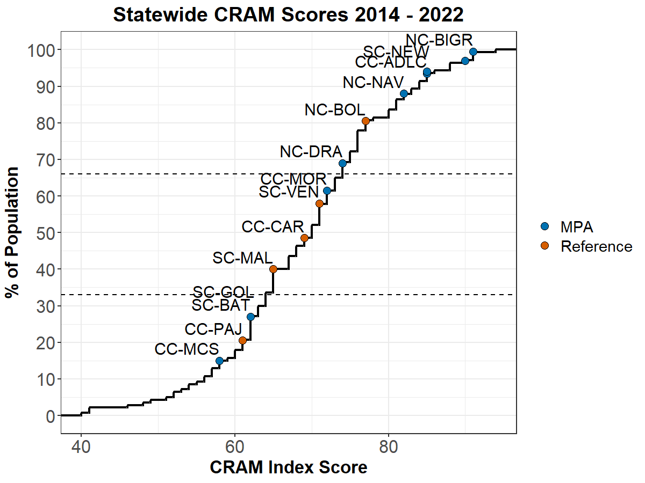
Context for Gauging Success
Ambient conditions
Reference conditions

Slide 22
Different Ways to Gauge Performance
A: Improvement from baseline
B: Comparison to ambient
C: Comparison to reference
C
B
A
Original condition
Notes:
Standards can be set relative to different benchmarks, as long as it is defensible

Slide 23
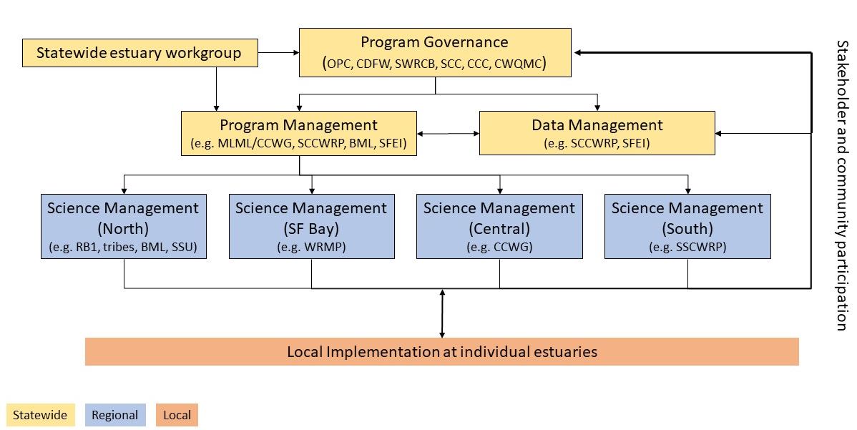
Coherence Across Different Levels of Monitoring

Slide 24
Meaningful Conclusions About Success Take Time
Long-term monitoring needs to be institutionalized through sustained regional monitoring programs
Monitoring should include measures of resiliency

Slide 25
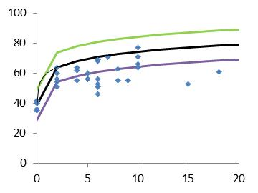
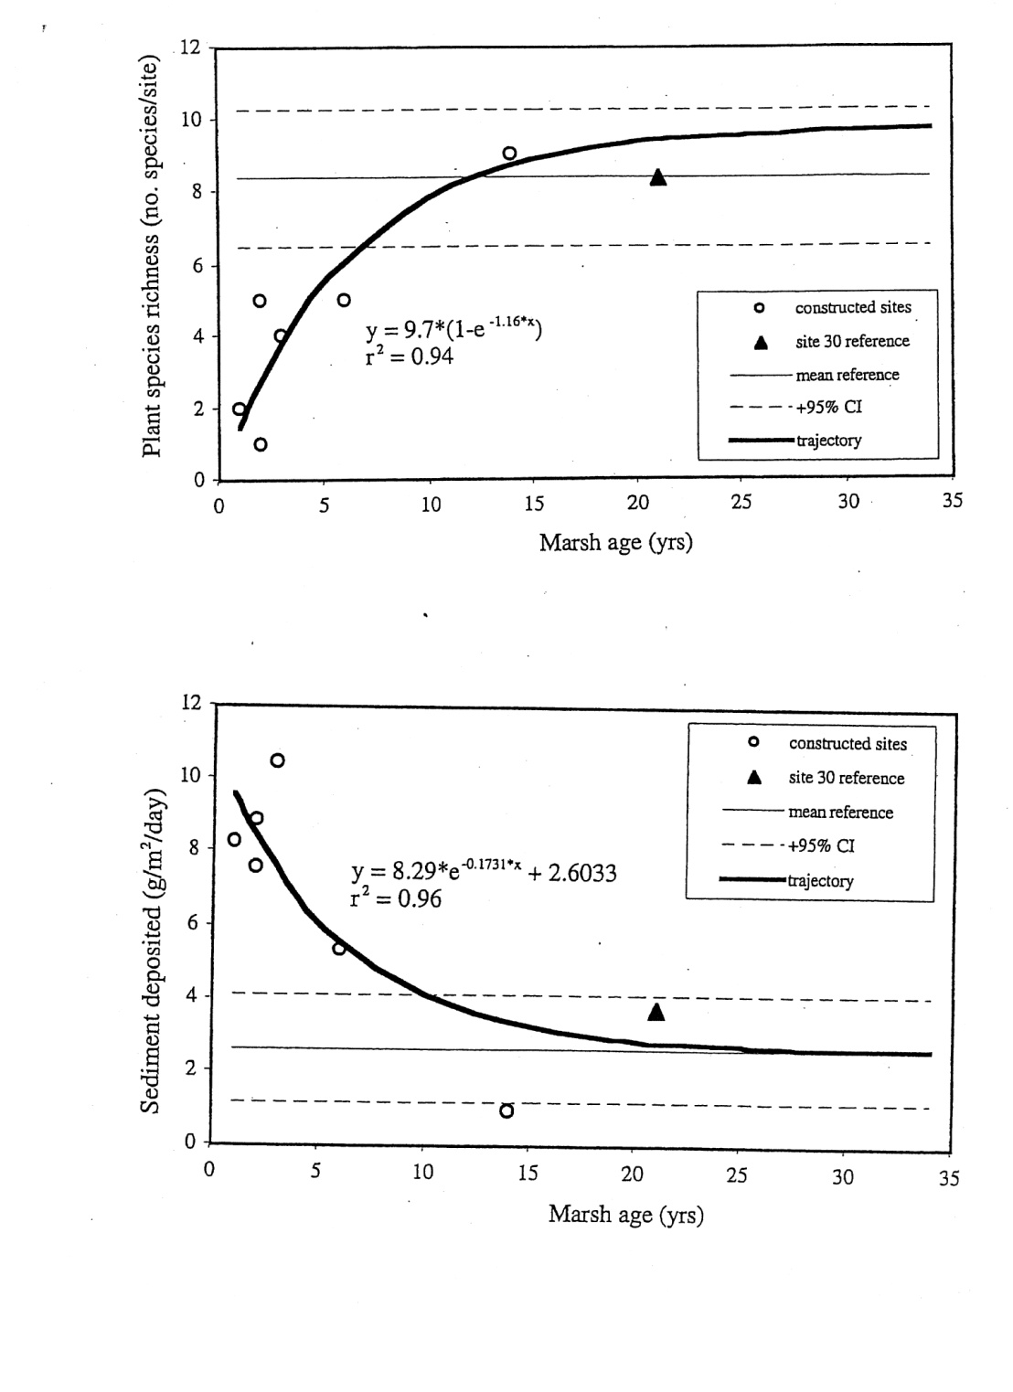
Success Takes Time
CRAM Score
Need for remedial measures
Morgan and Short 2002
Age (years)

Slide 26
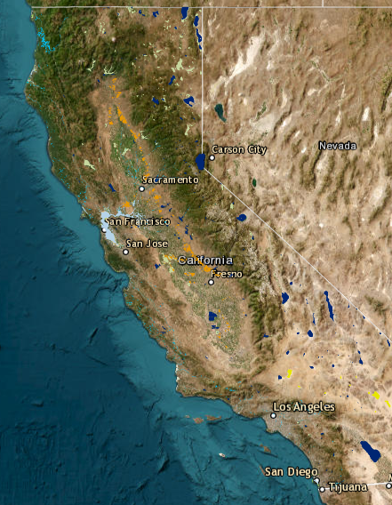
Leverage Regional Monitoring Programs
Estuarine Marine Protected Area Program
  Statewide
San Francisco Bay
  Wetlands Regional Monitoring Program
  Interagency Ecological Program
Southern California
  Bight Regional Monitoring Program
  Wetlands Recovery Project Monitoring Program
USEPA National Estuary Program
  San Francisco Bay, Morro Bay, Santa Monica Bay
NOAA National Estuary Research Reserves
  San Francisco Bay, Elkhorn Slough, Tijuana Estuary
San Onofre Nuclear Generating Station Mitigation Program
  San Dieguito, Tijuana, Mugu Lagoon, Carpinteria Salt Marsh
SF Bay Programs
S CA Programs

Slide 27
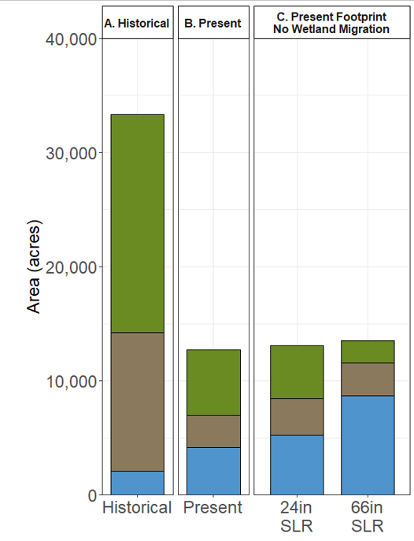
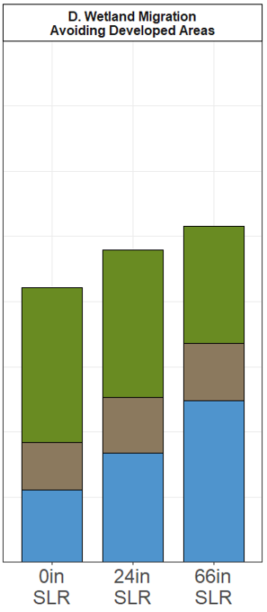
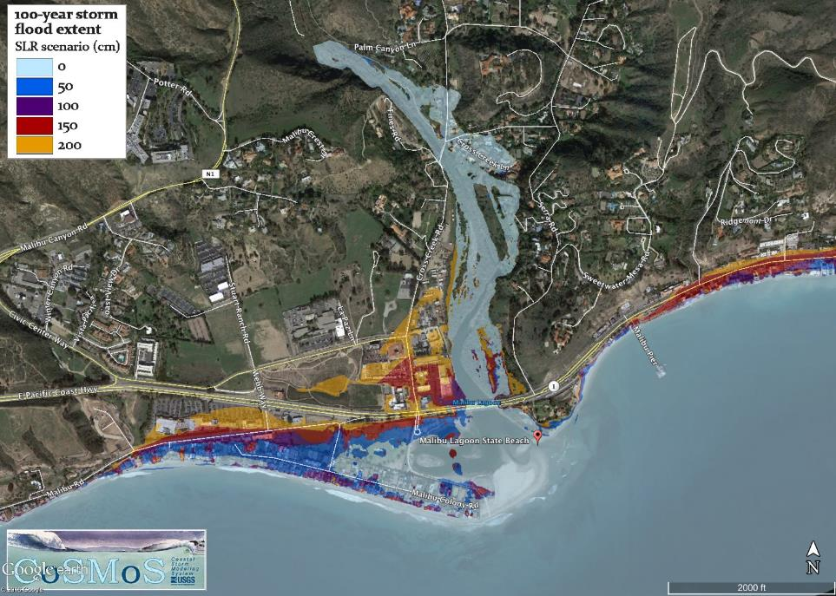
Account for Future Conditions
Historic
Present
Desired Future Objectives

Slide 28
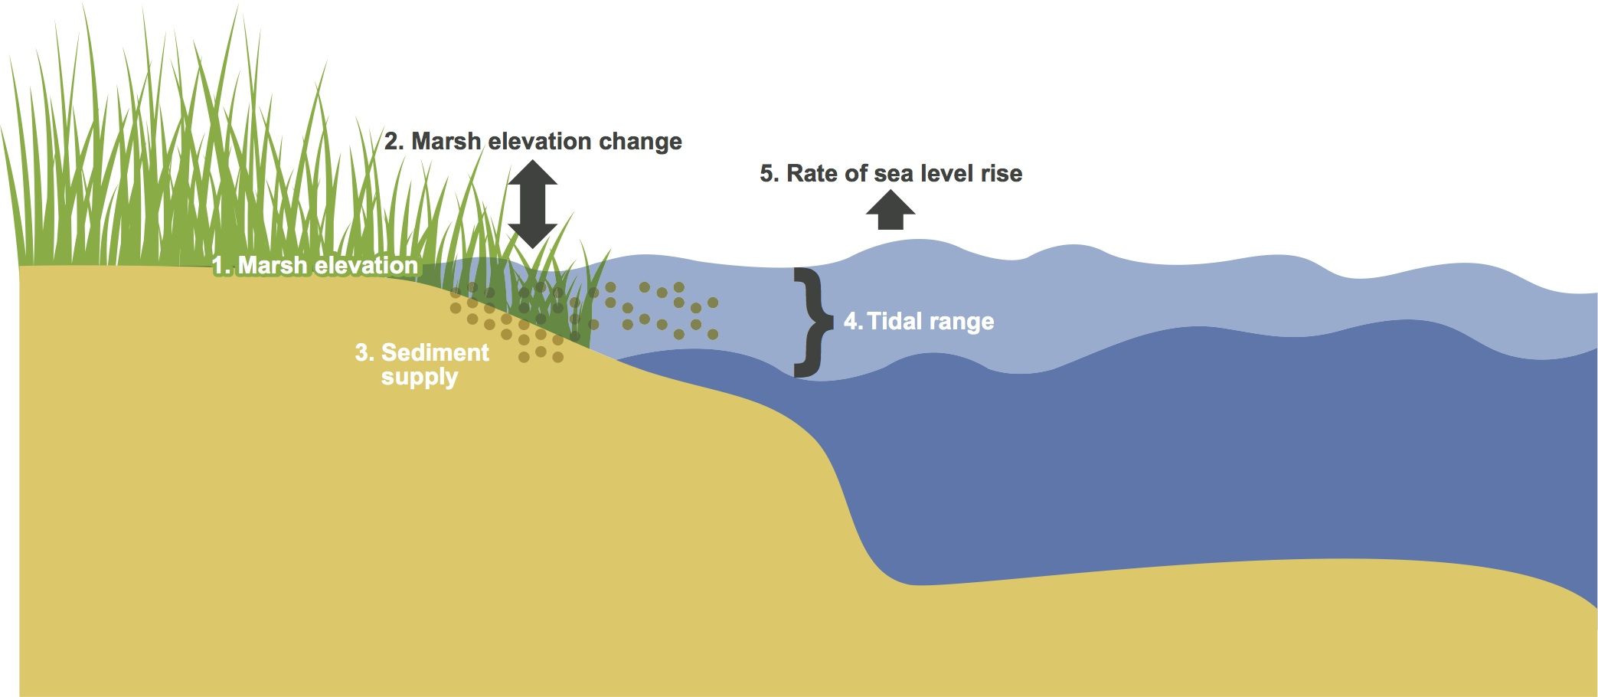
Include Indicators of Resiliency

Slide 29
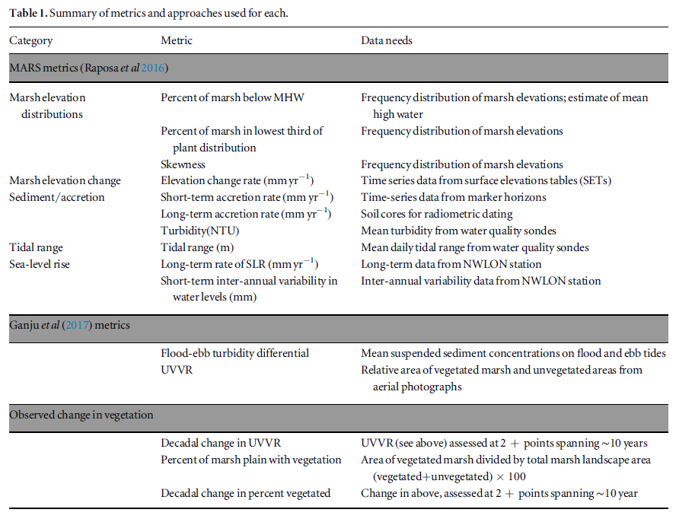
Wasson et al. 2019

Slide 30
None of it Matters if You Can’t Access and Interpret the Data
Strive for an integrated, electronic data flow through all steps of the data management process from data collection through publication
Manage data in a geospatial format to enhance data visualization and interpretation and facilitate data integration across programs
Use an open data format that includes web services and application program interfaces (APIs) to facilitate data

Slide 31


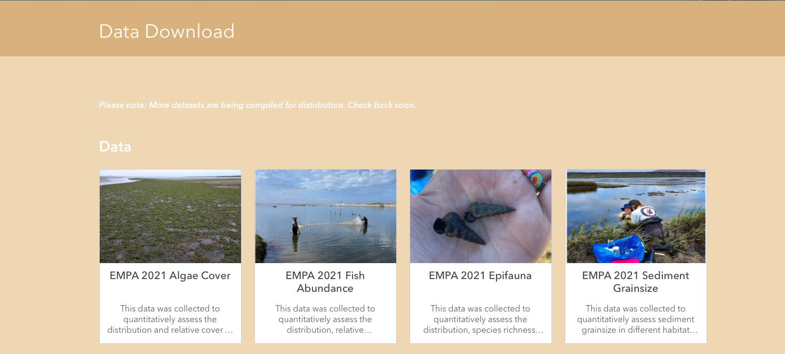
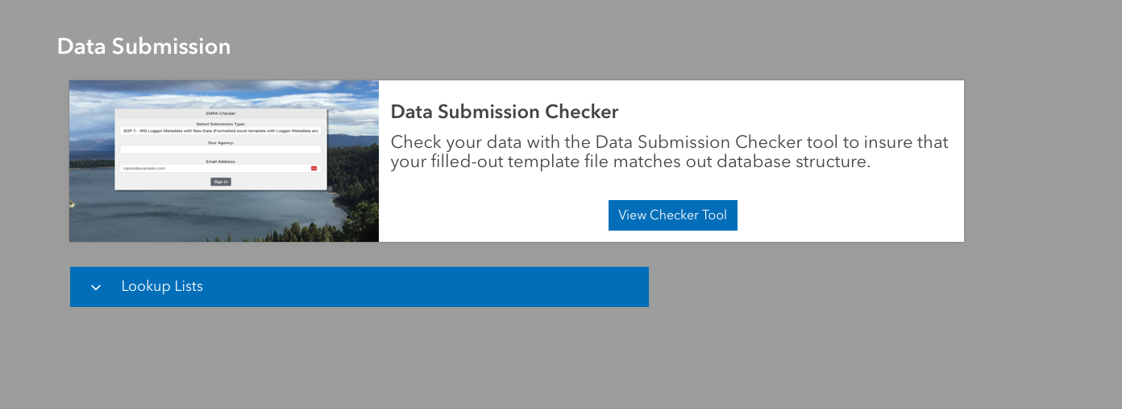
Standard Data Assembly and Infrastructure to Increase Comparability and Encourage Collaboration
https://empa.sccwrp.org

Slide 32
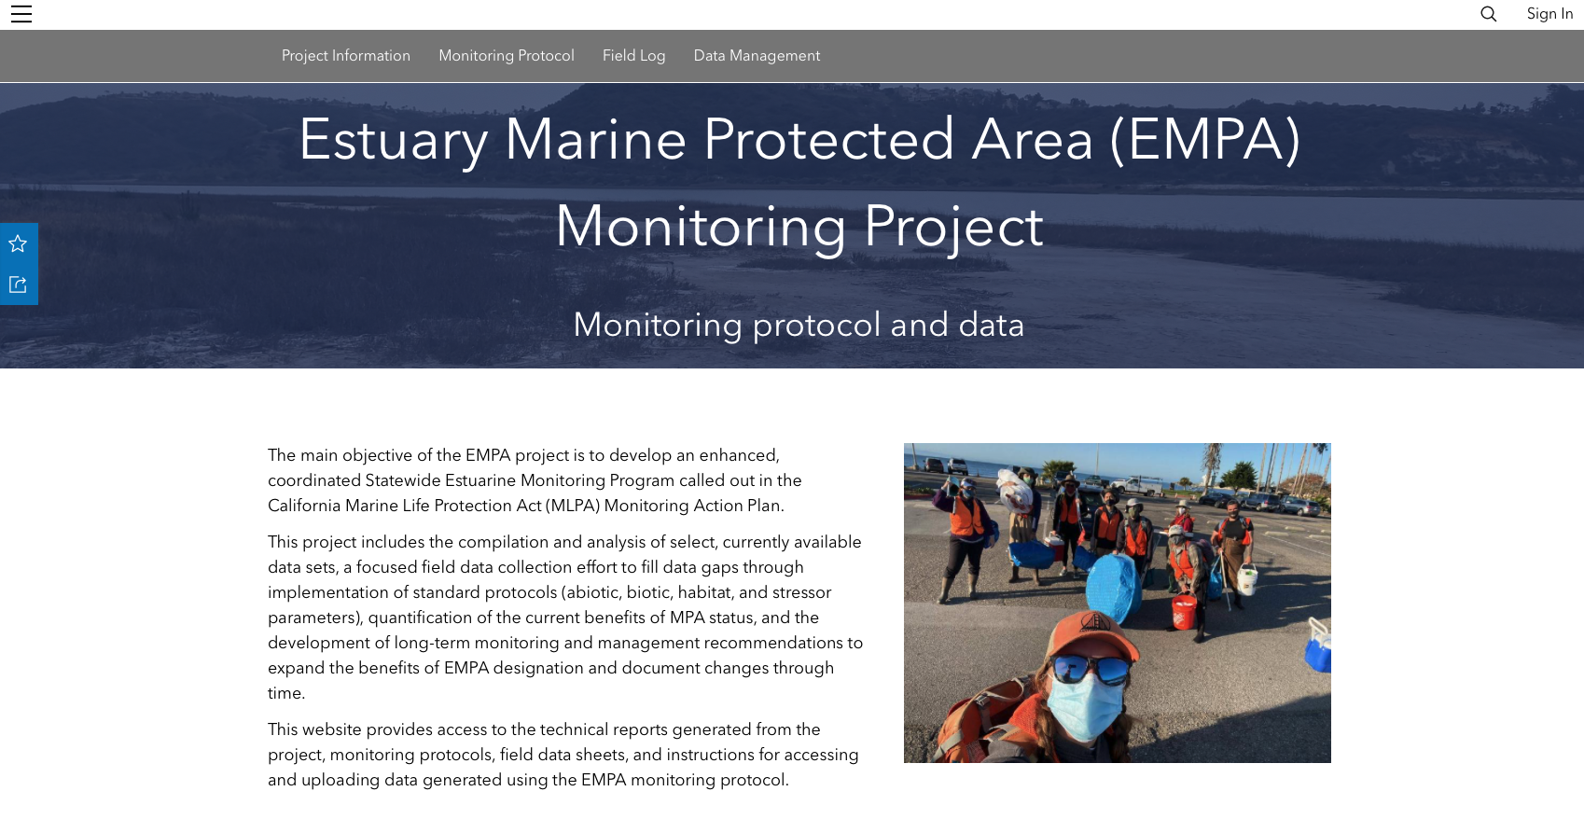
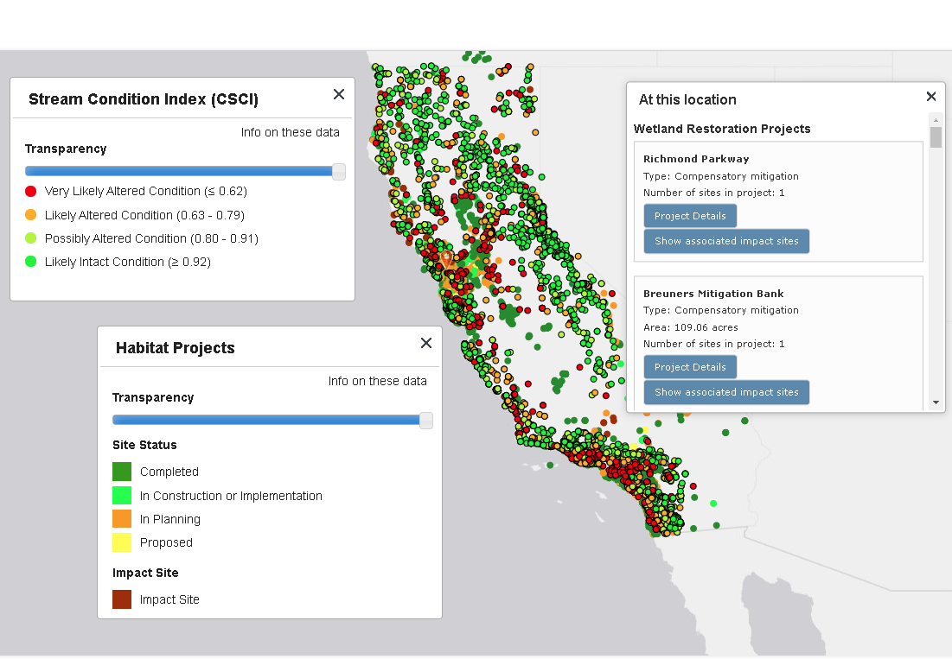


https://empa.sccwrp.org

Slide 33
Lessons Learned in California
Build trust
Find common ground
Identify low-hanging fruit
Generate early success
Demonstrate value
Tell your story
Success is in the eye of the beholder
Collaboration is key to gauging success
Evaluation of success requires context
Meaningful conclusions about success take time
None of it matters if you can access and interpret the data

Slide 34
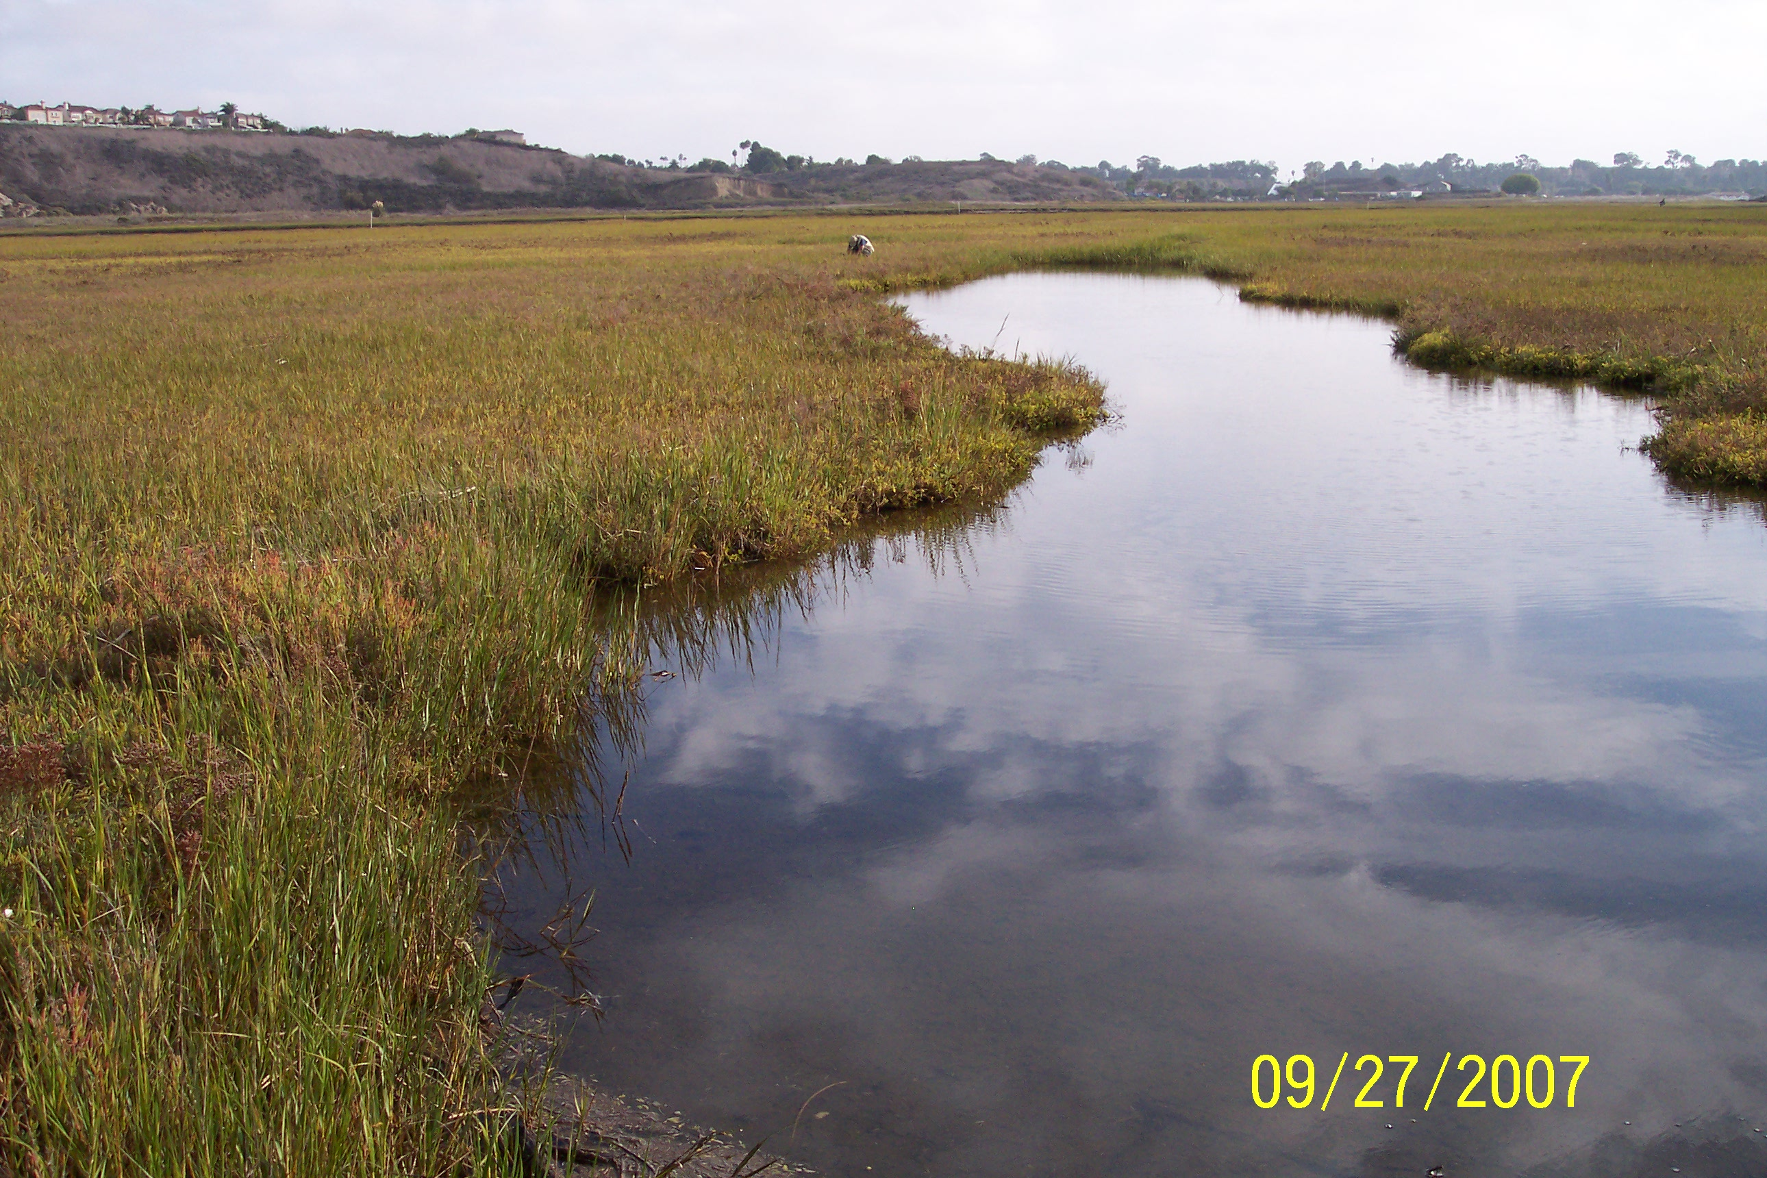
Thank you!
Eric Stein
erics@sccwrp.org
www.sccwrp.org
714-755-3233

Slide 35
EXTRA SLIDES

Slide 36
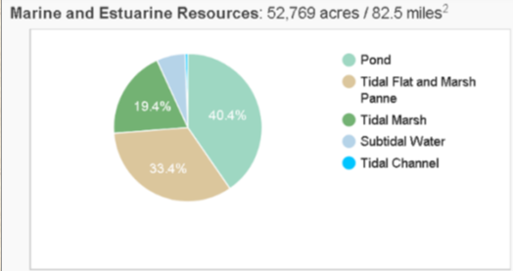
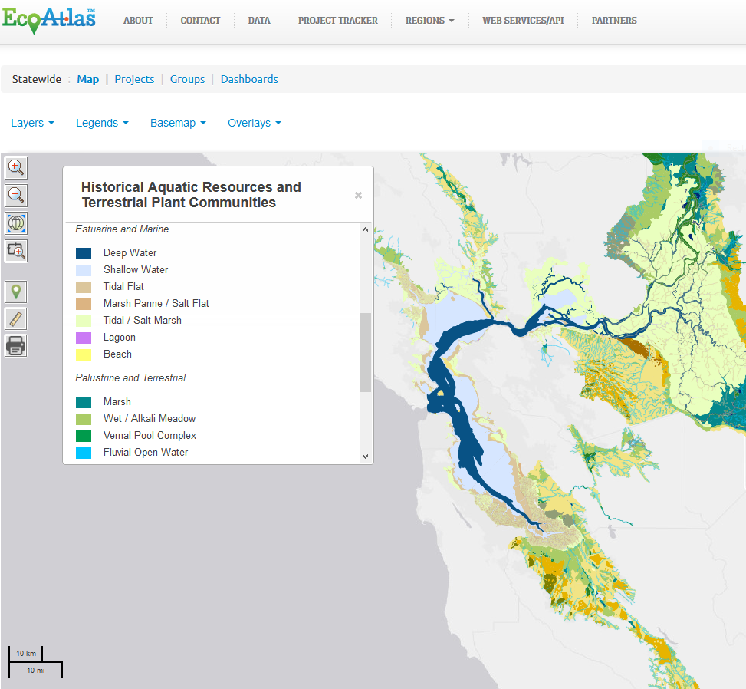
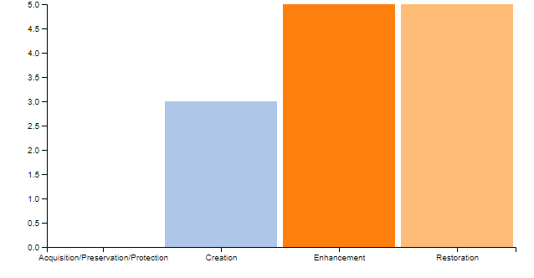


Targets Based on Landscape Profiles
62% of target restoration goal
Notes:
Out of kind mitigation OK if it contributes to regional goals

Slide 37
Keys to success
Don’t force it – find common ground
Everybody is busy and this is nobody’s job
  Need a designated “point person”
  Empower key motivated individuals
  Encourage leaders to emerge
Remove all barriers to information flow
  Informed participants are engaged and supportive participants……that includes the public

Slide 38

Keys to Success
Establish a clear and common vision & stick to it
  Things that directly affect the problem are part of the solution -others things lead to other problems.
Start modestly, learn as you go
Obtain early successes and relish in them
Stay engaged -- don’t be complacent
Think/plan regionally . . . . Act/implement locally

Slide 39
Protocols Can be Used to Develop Appropriate Performance Standards
Measures a single aspect of condition or function
Can be measured objectively in a repeatable manner
Clear and unambiguous
  Somebody else will likely have to interpret what you meant
Defensible
Readily quantifiable targets with known levels of confidence
Tied to established goals and objectives
Can inform adaptive management actions and/or contingency actions

Slide 40


Example Performance Standard
At the end of year 3, at least 80% of Area A shall have a benthic invertebrate index score within 10% of the median reference population score.
  If this standard is not met, the site will be re-evaluated within 120 days of the original field assessment
  If the standard is still not met, metric level analysis and/or causal assessment shall be conducted to identify likely reasons for failure

Slide 41
Indicator | Metric | Questions
 |  | Stressors | Condition | Resilience
Habitat | Extent marsh
 | Extent seagrass bed
 | Habitat diversity
 | % buffer, transition zone
WQ | Temp
 | DO
 | Salinity
 | Chlorophyll a
 | Turbidity
Vegetation | Extent, diversity, % invasive/native
 | Percent marsh below MHW
 | UVVR – relative area of vegetated marsh and unvegetated (aerial photos)
 | Percent of marsh in lowest third of plant distributions

Slide 42
Key Elements of Resiliency
Condition
Diversity
Complexity
Vulnerability
Exposure
Sensitivity
Adaptive Capacity
Transgression
Migration
Accretion
Consistent Approaches
Regional Plans
Innovative Tools
Identify opportunities based on conservation needs and societal benefits

Slide 43
